Slide 1

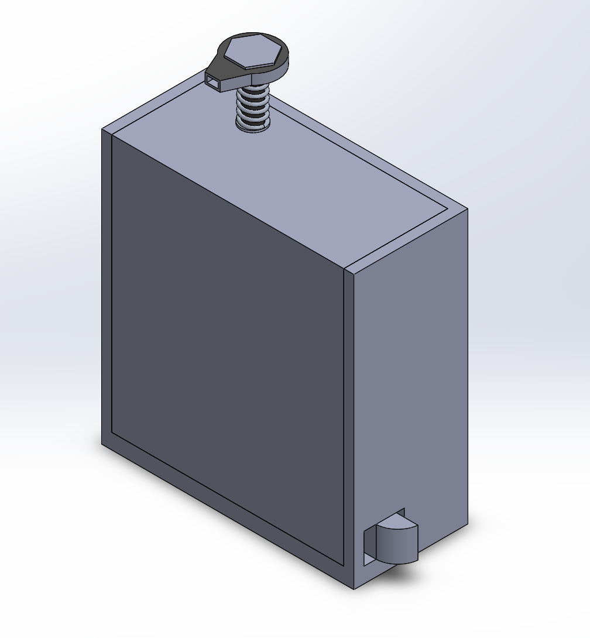
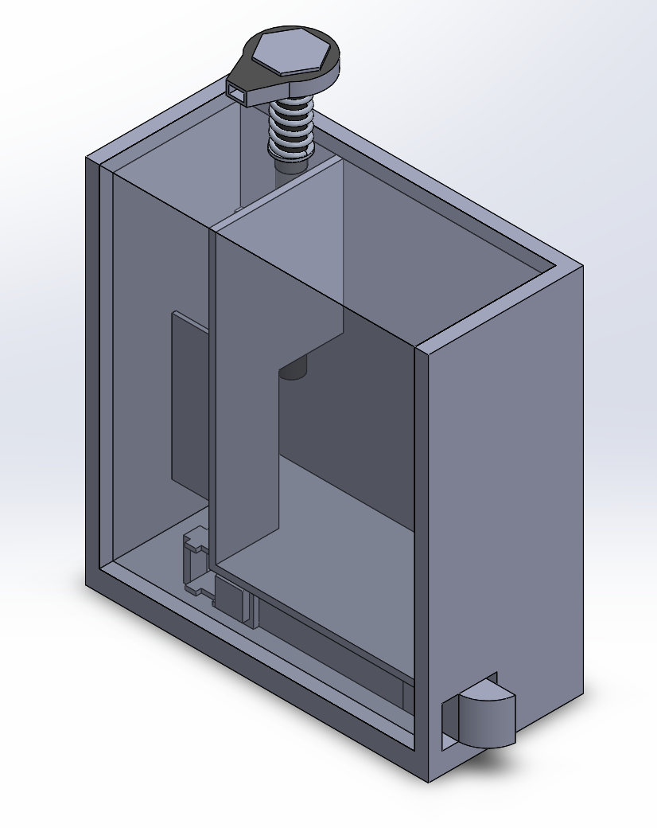
Engineering Portfolio
Initially designed as part of the EWB challenge, dubbed “Fresh Hands”. This is the 3rd iteration of the design. This door handle requires the user to use the sanitiser dispenser in order to move the latch. This ensures that all who pass through the door, have clean hands.
Original focus was for use on toilet cubicles, however the principle idea has many more applications. Early estimates for a compactly sized system require 2 refills of sanitiser pouches per day in a public toilet.
Thomas Lando

Slide 2
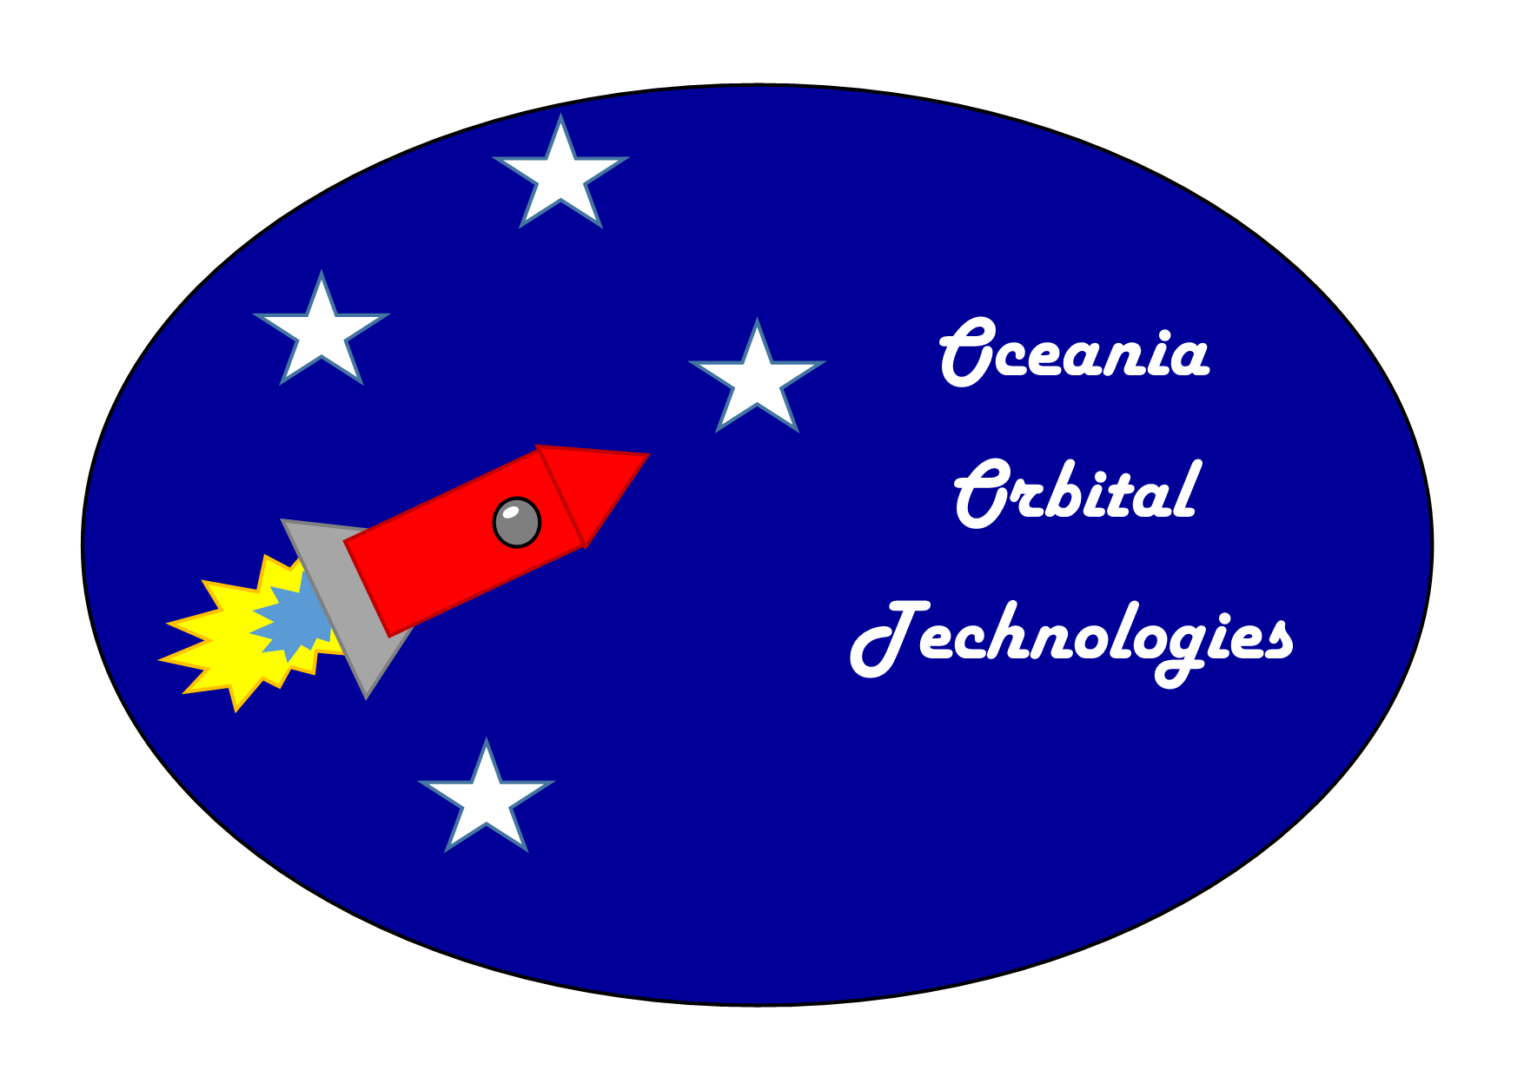

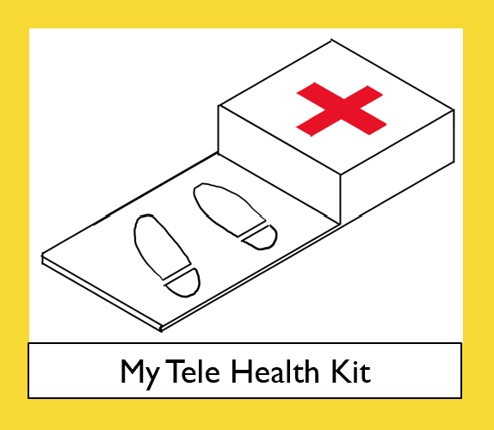
Have developed concepts for a medical app and device to allow doctors to reach patients without the need to be face to face. Dubbed “My Second Opinion” and “My Telehealth Kit” these were created as a part of the EWB Big Design Challenge
Currently developing a Rocket Launch Simulator. Eventual goal is to provide accurate and valuable data within a web app. The latest version uses terminal commands in Python. Visuals are still in progress. The current Source code is available through the link below.
https://github.com/thomas-lando-18/Rocket-Sim

Slide 3

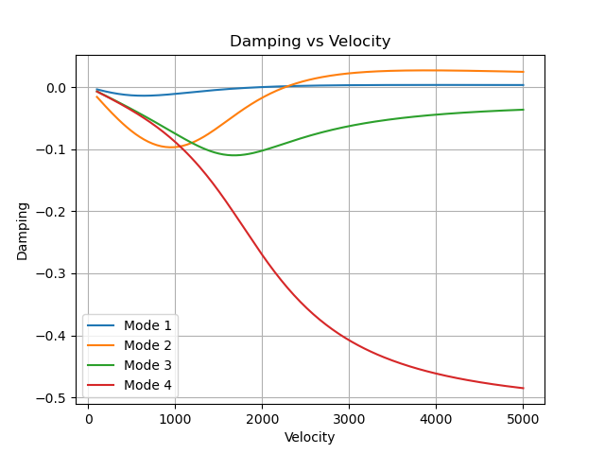
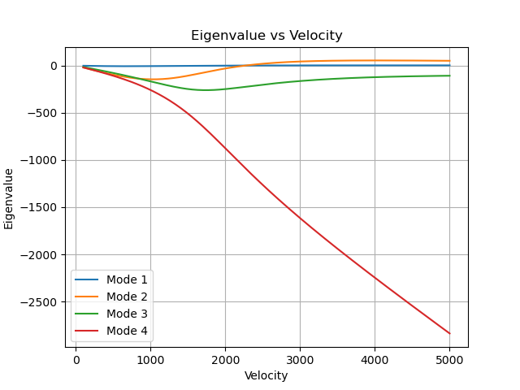
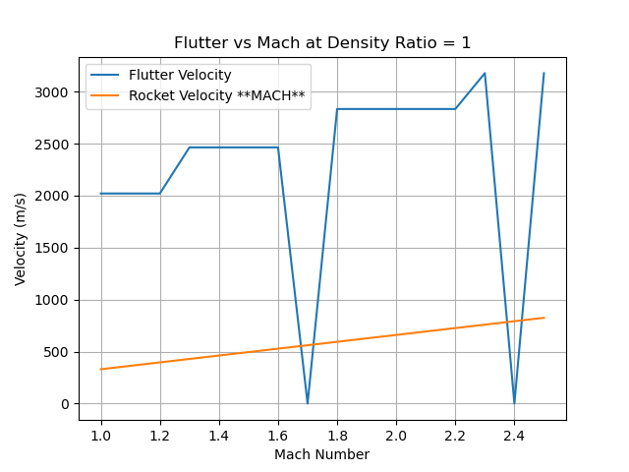
As a part of the USYD Rocketry team, I am involved in the development of a new design software package that should be ready within the next 3 to 6 months.
My section involves automating the flutter speed analysis of the rocket fins using python and MSC Nastran. Unfortunately, I don’t have permission to share code. However, the code generates the following plots.

